Slide 1
The Effects of Landscape Characteristics and Climate Variables on West Nile Virus Infection Risk in Massachusetts
Weizhi (Vanchy) Li, prof. Florencia Sangermano
Graduate School of Geography, Clark University
Notes:
Hello, everyone, my name is Vanchy Li. Today the topic I am going to present is “ the effects of landscape characteristics and climate variables on West Nile Virus infection risk in Massachusetts”. This project is collaborated with my advisor prof. Florencia Sangermano.

Slide 2
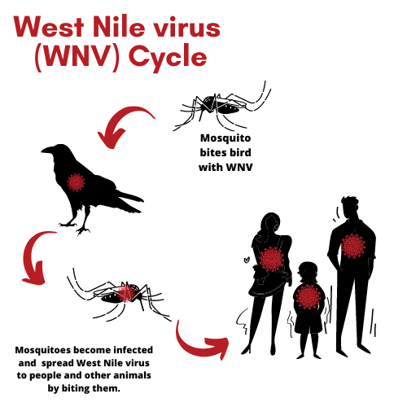
Introduction
West Nile Virus Transmission Cycle
(source: orange county mosquito and vector control district)
Notes:
Speaker’s Note:
The West Nile Virus is a pathogen carried primarily by Culex mosquitoes. Its primary hosts are wild birds, but other animals like horses and humans could be incidental hosts as well. Symptoms of WNV infection for a human can range from fever to encephalitis and even cause death. The intensity of transmission and the risk of endemic circulation of WNV depend on the abundance and distribution of infected mosquitoes, ecological conditions, and animal behavior. It is known that the ecological conditions and landscape structure play an important role in mosquito reproduction and activity. Thus, we are interested in finding what kind of landscape and environmental factors would affect the distribution of infected mosquitoes, so that we could gain more information on developing more intact ecosystems that carry fewer infected mosquitoes and help control and mitigate the spread of this disease.

Slide 3
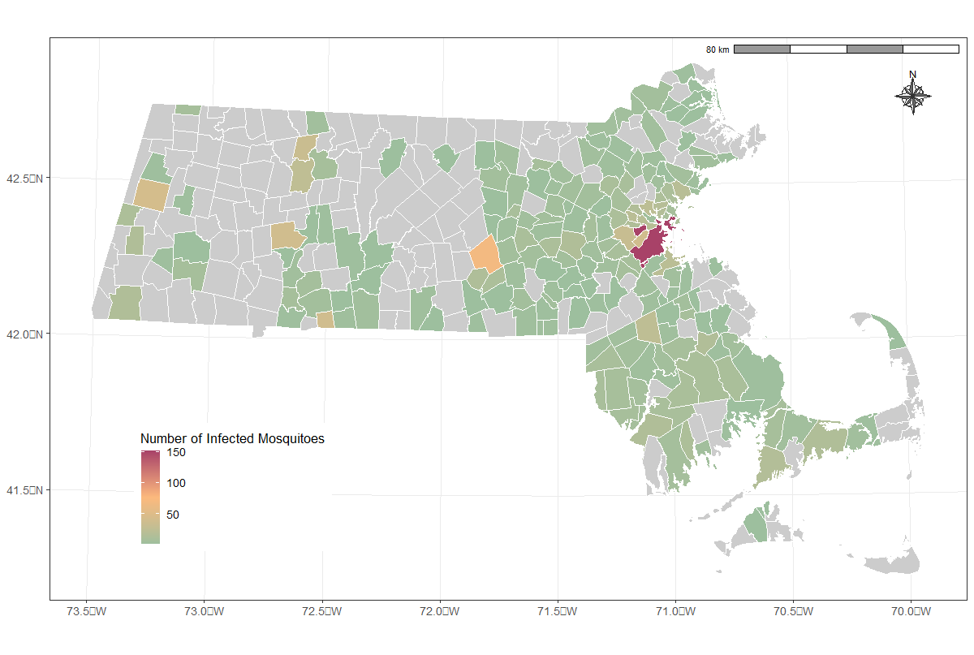
Study Area and Infected Mosquitoes
Massachusetts Town-Level WNV Infected Mosquito Cases, 2014-2020
Notes:
Speaker’s note:
Massachusetts is located in the northeastern region of the United States and comprises 351 towns. The map displayed here is the data on the number of infected mosquitoes that were collected at the town level by the Massachusetts Department of Public Health from the years 2014 to 2020. The grey represents no-data. 185 out of 351 towns have data. In this map, the redder means the more number of infected mosquitoes recorded in a town.

Slide 4
Objectives
Identify Hotspot Areas for WNV
Predict WNV distribution across the state
Find out most correlated variables
Help mitigate the risk of WNV spreading
Notes:
Speaker’s note:
The objecteives of our study is to identify hotspot areas for West Nile Virus infection, and find out the most correlated landscape and climate factors of the hotspot areas. After that, we predict the distribution of west nile virus mosquito numbers arcoss the state at the town level. Finally, we try to conclude what we found to help decision-makers develop a more effective strategy to reduce mosquito population and mitigate the spread of WNV disease in affected area.

Slide 5
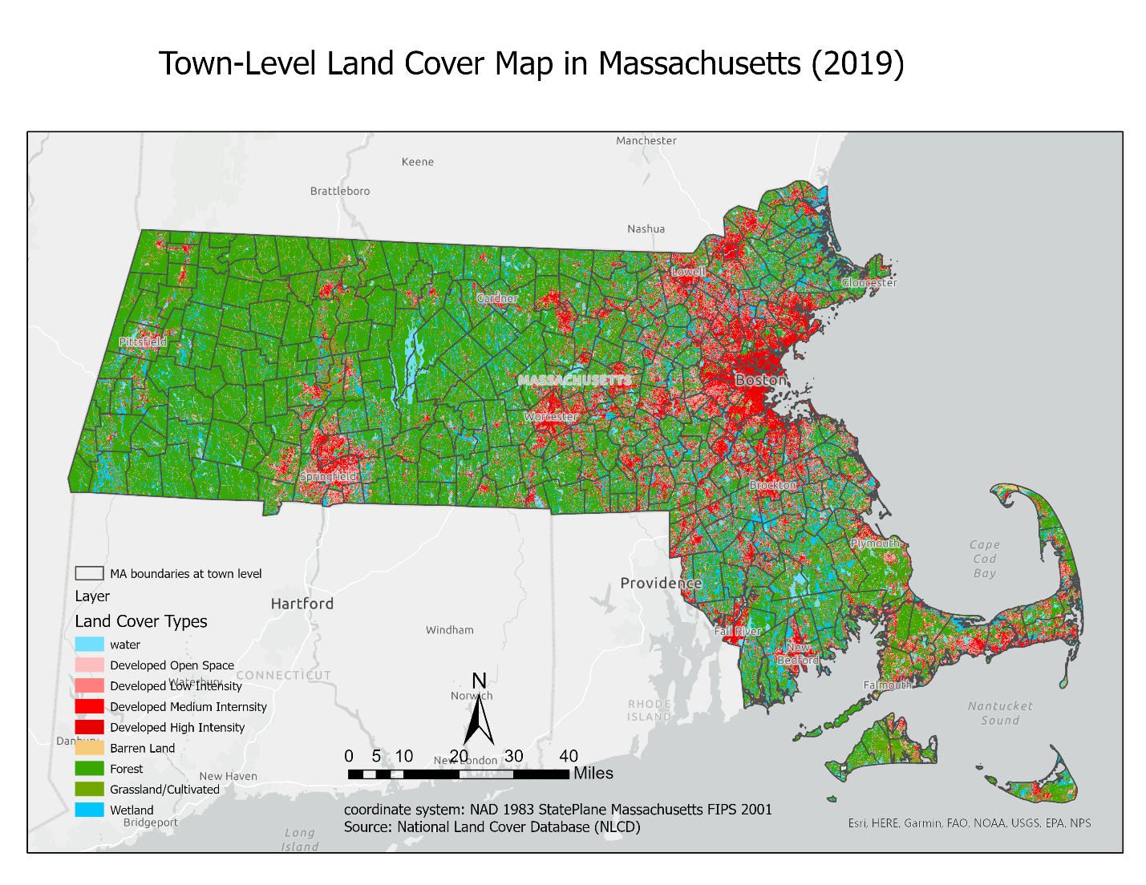
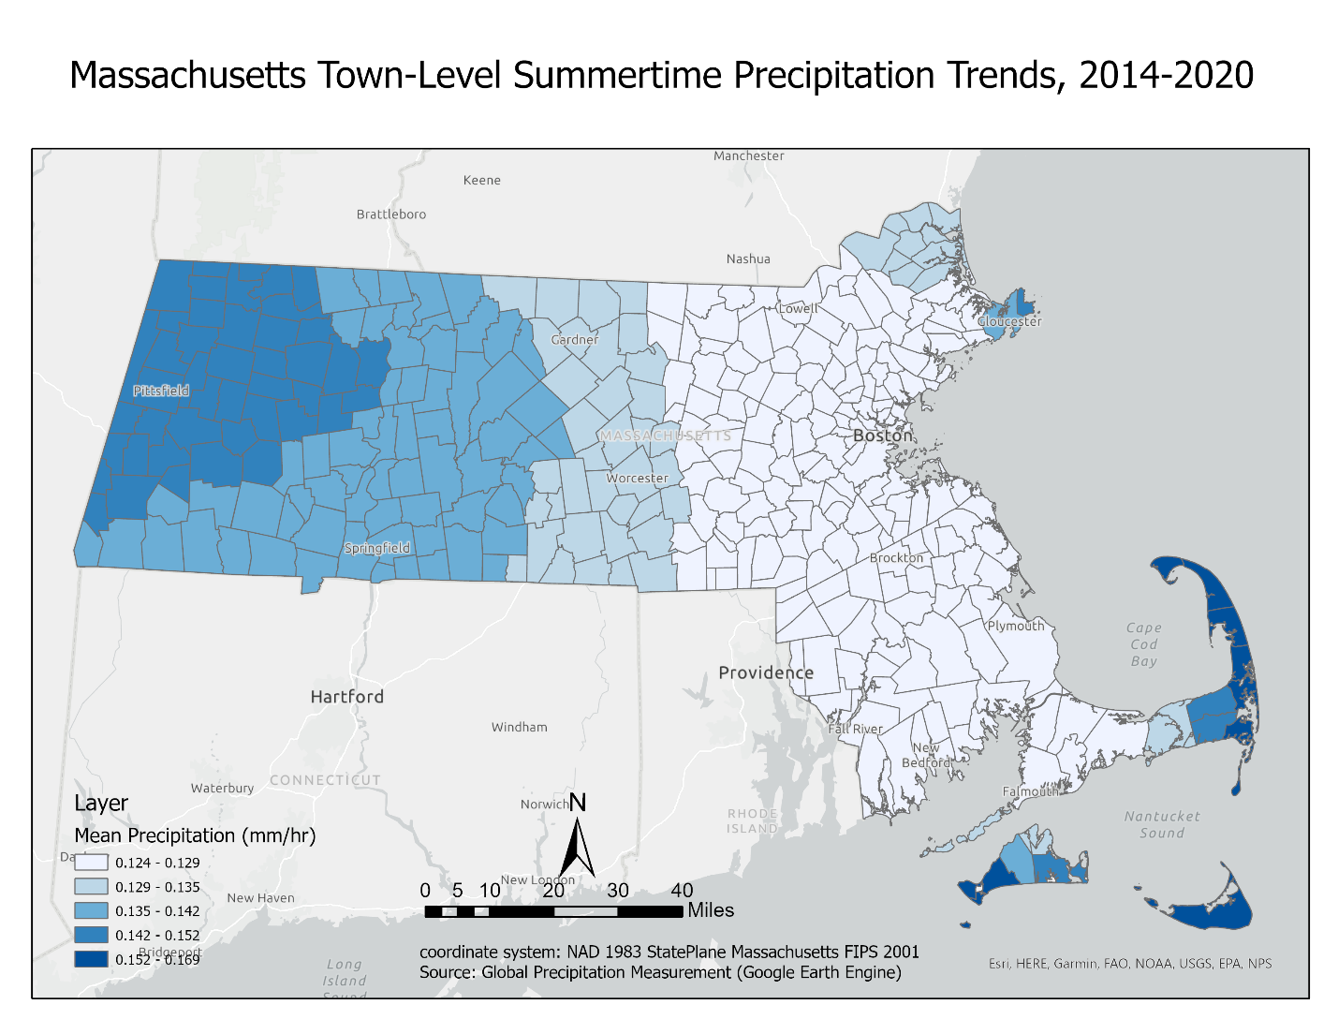
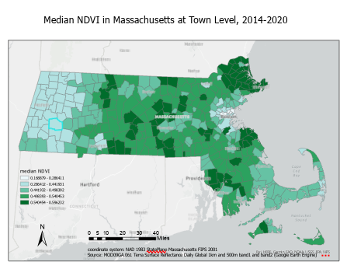
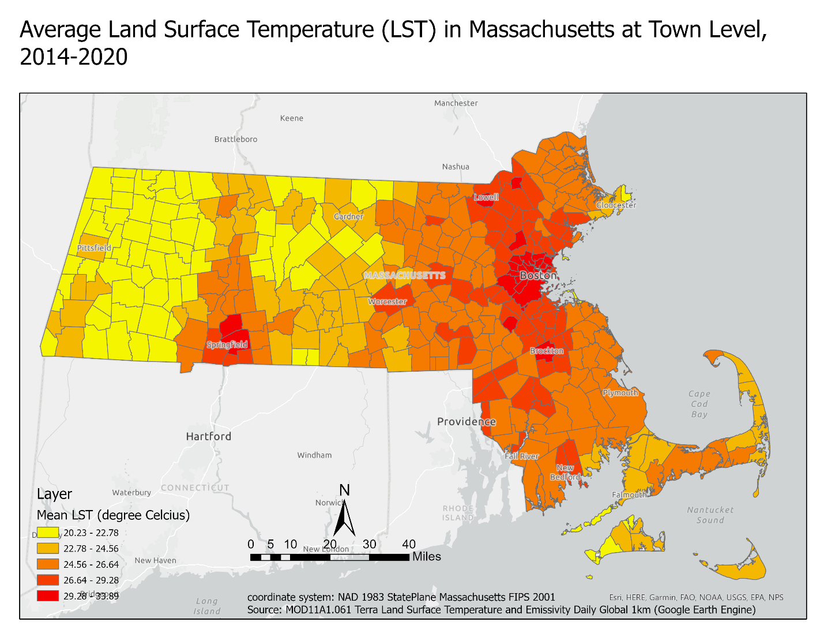
DAta
Notes:
Speaker’s note:
For this study, we investigated landscape and climate factors. The landscape factors are derived from landscape metrics at the class and landscape level. The landscape metrics is a quantitative measurement used to analyze the spatial characteristics of different land cover types. For this project, we downloaded and reclassified the 2019 land cover map of Massachusetts from NLCD, the National Land Cover Database, into 9 land cover types, including water, urban areas, forest, grassland, agricultural areas, and wetland. The reclassified land cover map was used to generate landscape factors.
The climate factors in our study includes the mean and median values of land surface temperature, precipitation, and NDVI at the town level, and they were extracted during the summertime from 2014 to 2020 by using Google Earth Engine.

Slide 6
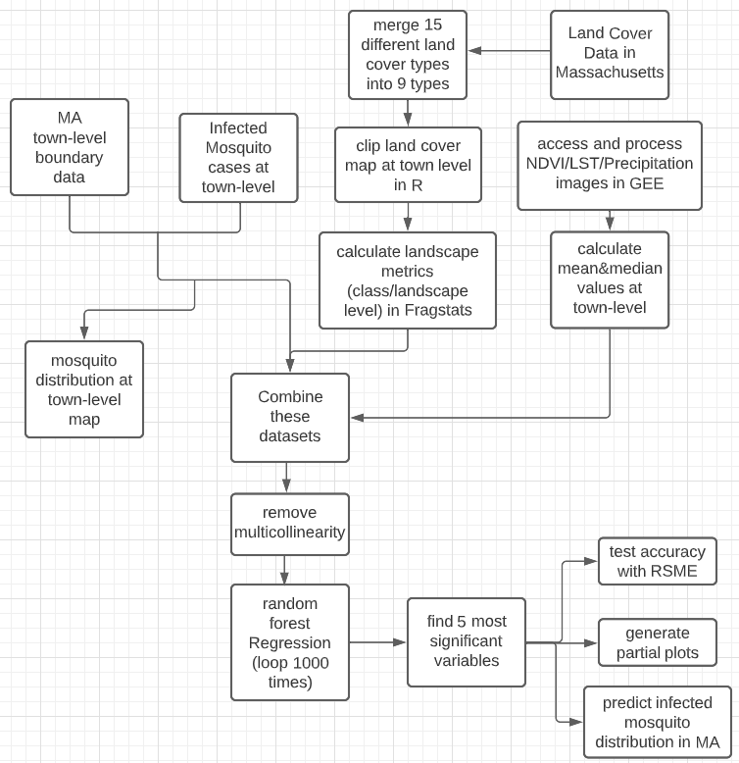
Methods
Model: Random Forest Regression Model
Responce variable: mosquito numbers in 185 towns
Factors: 78 variables (72 landscape variables + 6 climatic variables) after the multicollinearity removement.
1. Looping the Random Forest model 1000 times to find out 5 most significant factors
2. Train the Random Forest by using these 5 most important factors to reach the lowest RMSE
3. Obtain the importance variable plot and partial dependence plots
4. Generate the Predicted infected mosquito distribution map at the town level
Notes:
Speaker’s note:
For the methodology, we applied the Random Forest Regression Model to identify the most important features that influence the distribution of infected mosquitoes in Massachusetts. And here is the flowchart of the process. The response variable was the number of infected mosquitos in each town, and 185 / 351 towns have recorded data. The factors included landscape variables from the reclassified land cover map, which are calculated by Fragstats software. The climate variables include mean and median value of NDVI, LST, and precipitation at each town. Totally, 78 out of 210 variables were selected as factors or predictors after the multicollinearity removement. The Random Forest model was trained using a 70-30 training-testing split and trained 1000 times to identify the top 5 most significant and stable features for predicting infected mosquito cases at the town level. The Root mean square error (RMSE), which measures how much difference between the real value with the predicted value, was used to calculate the accuracy of the model. In addition, the importance variable plot and partial dependence plots were generated to depict the relationship of these 5 topmost factors with the number of infected mosquitoes. The final step is to generate the predicted infected WNV mosquito distribution map for all towns based on the random forest model generated by the 5 most important factors.

Slide 7
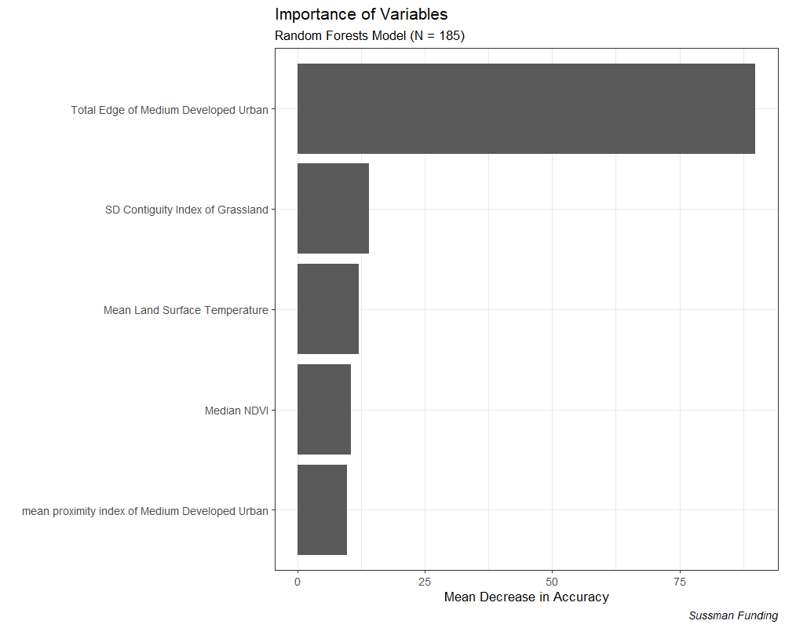
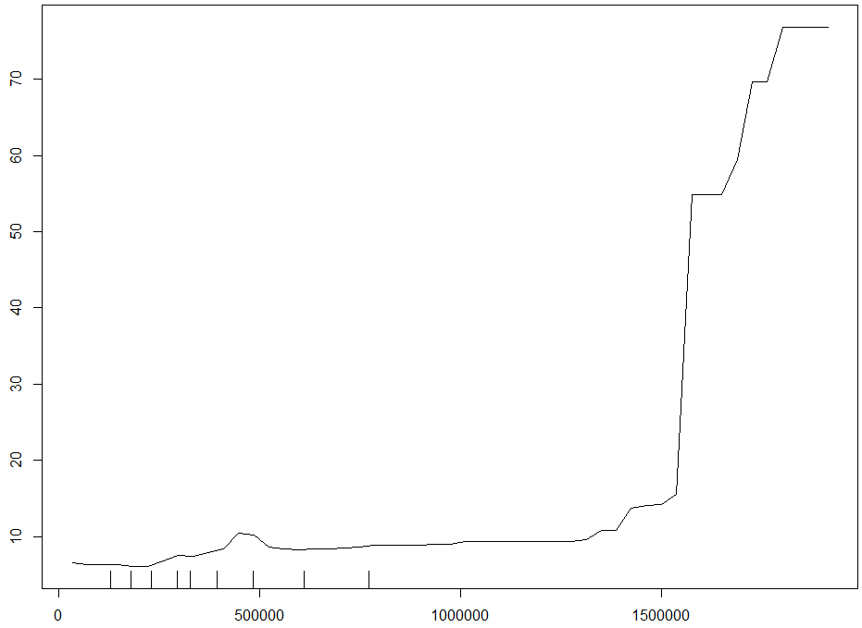
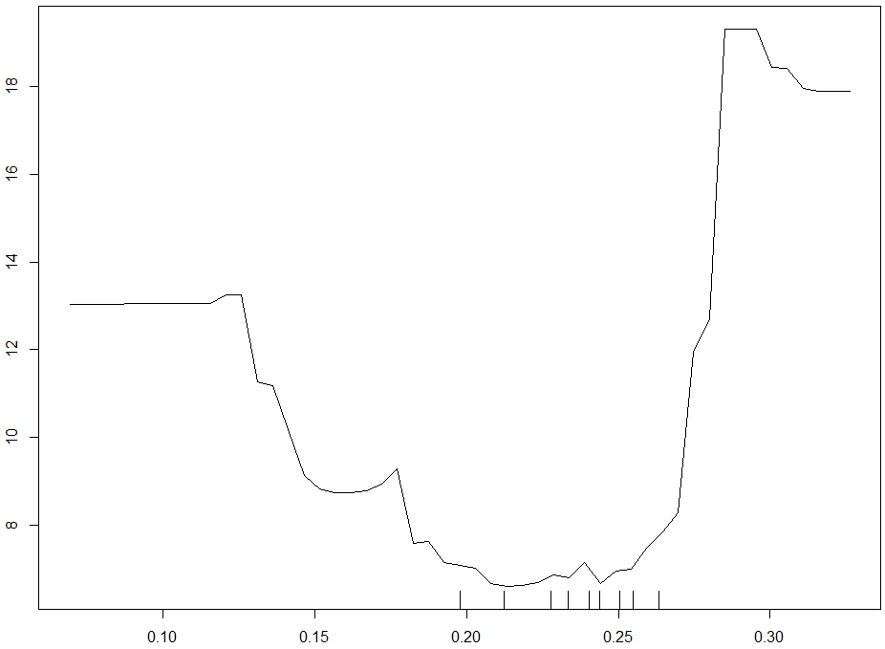
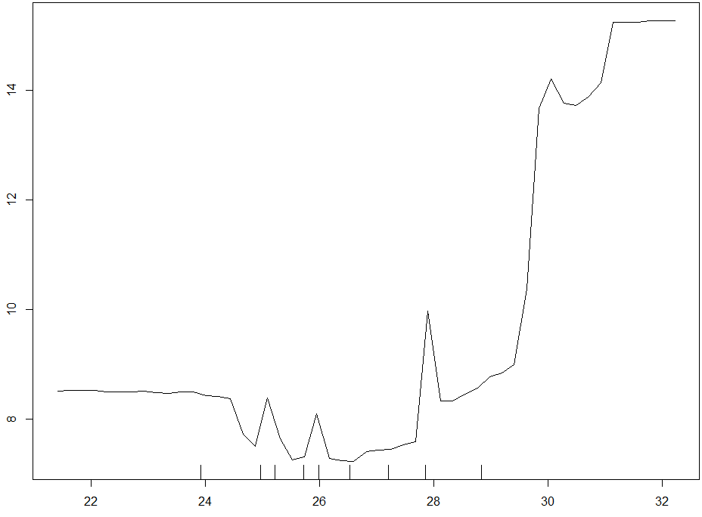
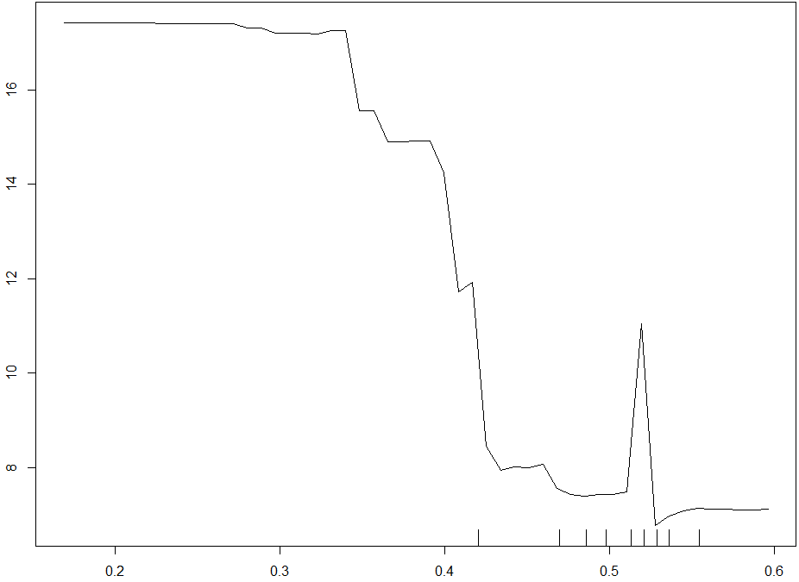
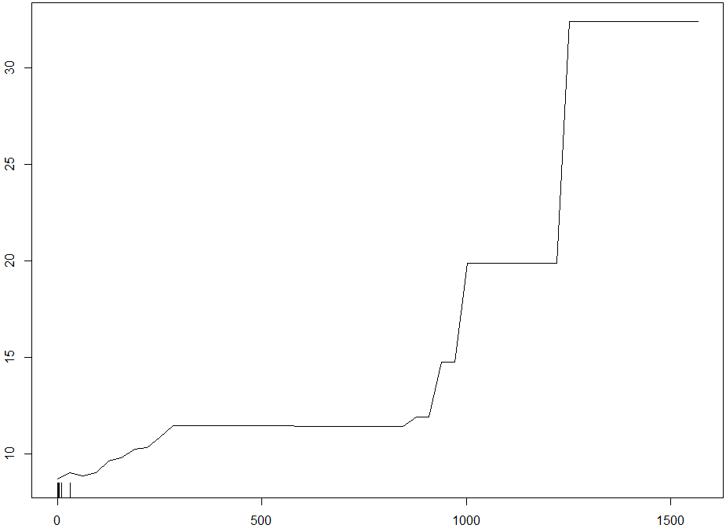
Results
Total Edge of Medium Develop Urban
Partial Dependence (Total Edge of Medium Developed Urban)
Partial Dependence (SD Contiguity Index for Grassland)
Standard Deviation of Contiguity Index for Grassland
Mean value of Land Surface Termperature
number of infected mosquitoes
Median value of NDVI
Mean value of Proximity Index of Medium Developed Urban
Meter
Partial Dependence (Mean Land Surface Temperature)
Partial Dependence (Median NDVI)
Partial Dependence (Mean Proximity Index of Medium Developed Urban)
number of infected mosquitoes
number of infected mosquitoes
number of infected mosquitoes
Degree Celsius
The Rank of Important Variables (left 1) and Partial Plots of 5 Topmost Important Features
Notes:
Speaker’s note:
Here is the importance variable plot for the top 5 important factors. TE_MedUrb is an absolute measure of the total edge length of the developed medium-intensity areas. SD_CI_Grass describes the variability in the connectivity of grassland patches. AVG_LST measures the mean LST temperature during the summertime from 2014 to 2020, which is obtained from MODIS Terra dataset. MED_NDVI is used to quantify the presence of living green vegetation in each town. AVG_PI_HUrb reflects the proximity of all developed medium-intensity urban area patches. The higher the proximity means the closer or less fragmented the medium-intensity urban patches. In general, the infected mosquito numbers have a positive relationship with the standard deviation of the contiguity index of grassland, land surface temperature, and total edge and proximity index of medium develop urban areas, while it has a negative relationship with the NDVI.

Slide 8
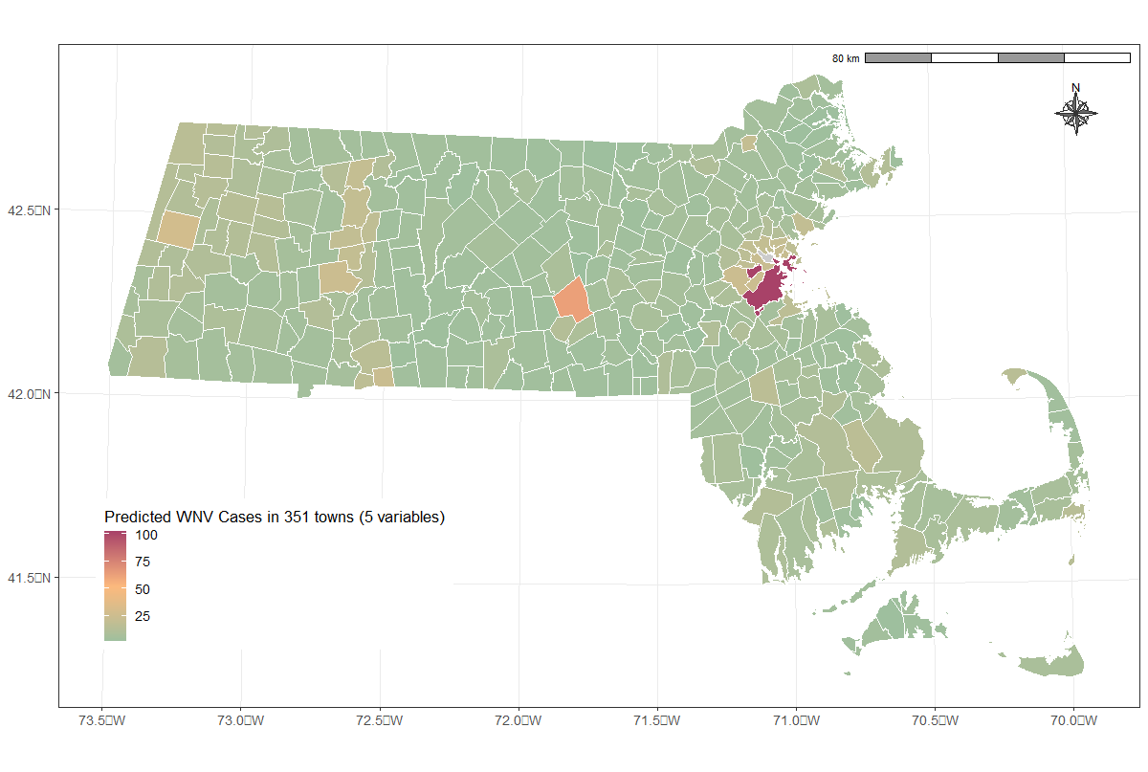
Results
Recorded Infected Mosquitoes in MA at Town Level
Predicted Infected Mosquitoes in MA at Town Level
RMSE: 5.45
Notes:
Speaker’s note:
So here is the result. The original mosquito distribution map was limited to data from only 185 towns. You could see on the left side. However, the Random Forest trained by 5 the most important features is able to create a predicted mosquito distribution map for all 351 towns in Massachusetts. The Root Mean Square Error is 5.45, which mean that, by average, the predictive model has 5.45 difference from the actual data. Besides that, by comparing the distribution of these two maps, you could tell that they are pretty similar for the data existing towns.
In the predicted map, Boston had the highest infection rate, with over 100 cases, represented in red. The Greater Boston and major towns are shown in yellow, while towns with predicted low numbers of infected mosquitoes are shown in green.

Slide 9
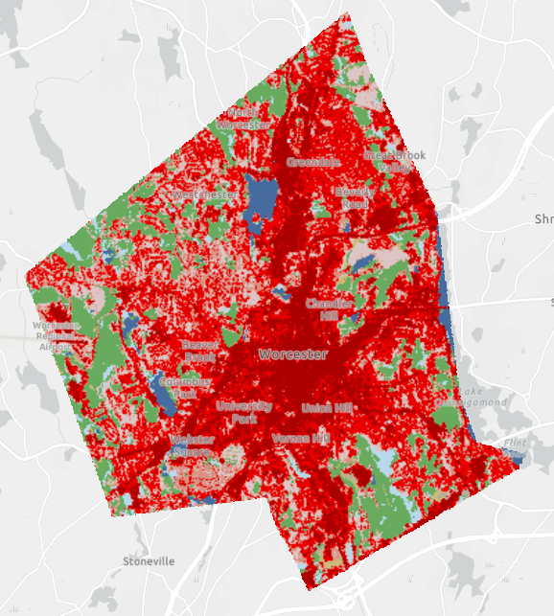
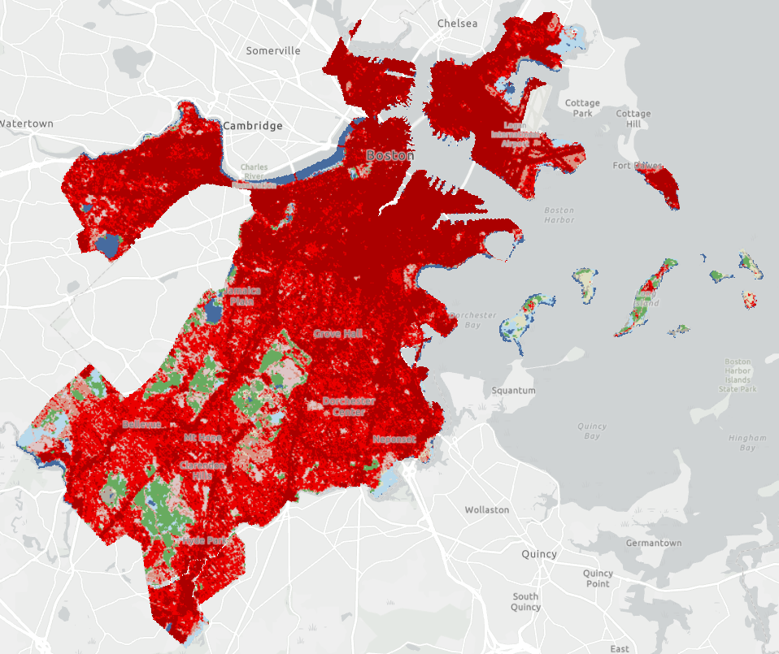
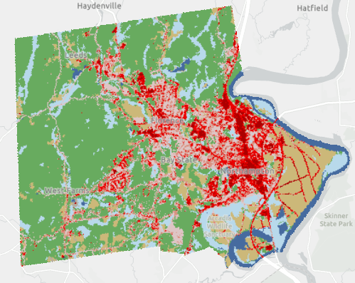
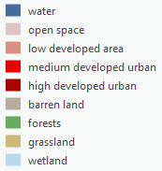

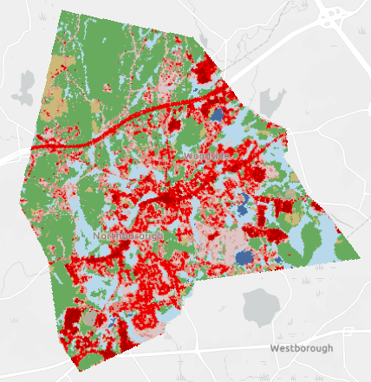
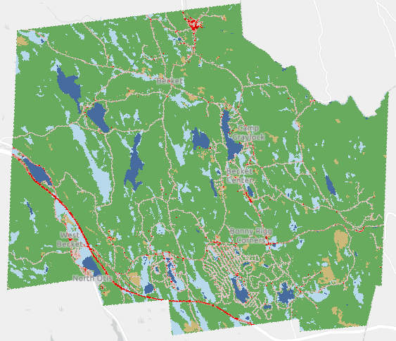
Results
Northampton Town: 38 case (real), 23 cases (predicted)
Worcester Town: 68 case (real), 62 cases (predicted)
Boston Town: 151 case (real), 102 cases (predicted)
Predicted Infected Mosquitoes in 185 Towns (have recorded cases) in MA
Becket Town: 1 case (real), 5 cases (predicted)
Northborough Town: 10 case (real), 8 cases (predicted)
Predicted Infected Mosquitoes in 185 towns and the land cover maps of 5 towns (Northampton, Worcester, Boston, Becket, and Northborough)
Notes:
Speaker’s note:
To better illustrate how landscape characteristics influence the number of infected mosquitoes, we extracted land cover maps from five towns with varying ranges of infected mosquito numbers. These land cover maps for each town provide a clear visualization of the relationship between the landscape and mosquito infection cases. Towns with higher levels of urbanization, such as Boston and Worcester, are likely to have more infected mosquitoes, while those with more forest cover, like Northampton and Becket, may have fewer. In addition, grasslands are also a significant factor in mosquito detection. For instance, Northampton and Northborough have similar urbanization levels, but Northampton has a more varied size of grassland patches, which could explain its higher rate of infected mosquitoes compared to Northborough.

Slide 10
Discussion
More total edges of the medium-intensity urban would potentially have more infected mosquitoes. Medium-intensity urban are more likely to be single-family housing units. Infected mosquitoes would prefer human residential areas.
More fragmented patches of grassland or crops would induce more mosquitoes. High variability of the connectivity of grassland suggests more infected mosquitoes.
An increasing land surface temperature would help incubate more infected mosquitoes. When the land surface temperature reaches 30 degree celsius, it would accelerate the number of infected mosquitoes.
The number of mosquitoes are high when NDVI was lower than 0.4 but decreased rapidly thereafter. This suggests the increasing of forest area would reduce the breeding of infected mosquitoes.
More concentrated medium-indensity urbanization is associated with a higher number of infected mosquitoes. The positive relationship between the proximity index of the medium-indensity urbanization areas and the number of mosquitoes supports this statement.
From the predicted map, Boston has higher mosquito numbers, with more than 100 cases, which are presented in red color. The following cities are cities around Boston and major towns in each county, such as Worcester and Pittsfield. Other towns with fewer mosquitoes are rended in green.

Slide 11
Conclusion
It was observed that mosquitoes infected with West Nile Virus are more commonly found in concentrated urbanized developed areas with irregular shapes, such as the Greater Boston.
It was found that Infected mosquitoes tend to thrive in areas with higher land surface temperature, lower vegetation coverage, and more grassland patches.
In order to mitigate West Nile Virus transmission, it is reasonable to focus on developed or urbanized areas because they are suitable areas for both human beings and infected mosquitoes. Increasing forest areas between urbanized towns helps to mitigate the infection rate.
Notes:
Speaker’s note:
As a result, it is important for the government and organizations to pay more attention to these areas and take some actions to mitigate or cut off the chain of transmission.

Slide 12
Acknowledge
The Edna Bailey Sussman Foundation funded this project. Professor Florencia Sangermano is the faculty sponsor for this project. Dr. Paula Ribeiro Prist from the EcoHealth Alliance was the project supervisor. Both Dr. Sangermano and Dr. Prist provided helpful advice for this research. Dr. Karen Frey guided the application and reported the process of this internship.

Slide 13
Reference
Allan, B. F., Langerhans, R. B., Ryberg, W. A., Landesman, W. J., Griffin, N. W., Katz, R. S., ... & Chase, J. M. 2009. Ecological correlates of risk and incidence of West Nile virus in the United States. Oecologia, 158(4), 699-708.
Boesing, A. L., Nichols, E., & Metzger, J. P. (2017). Effects of landscape structure on avian-mediated insect pest control services: a review. Landscape Ecology, 32, 931-944.
Gökyer, E. 2013. Understanding landscape structure using landscape metrics. In Advances in landscape architecture. IntechOpen.
Gustarfson, E. J., G. R. Parker. 1992. Relationships between landcover proportion and indices of landscape spatial pattern. Landscape Ecology 7: 101-110
McGarigal, K. 1995. FRAGSTATS: spatial pattern analysis program for quantifying landscape structure (Vol. 351). US Department of Agriculture, Forest Service, Pacific Northwest Research Station.
Paz, S., & Albersheim, I. (2008). Influence of warming tendency on Culex pipiens population abundance and on the probability of West Nile Fever outbreaks (Israeli case study: 2001–2005). EcoHealth, 5, 40-48.
Pradier, S., Leblond, A., & Durand, B. (2008). Land cover, landscape structure, and West Nile virus circulation in southern France. Vector-Borne and Zoonotic Diseases, 8(2), 253-264.

Slide 14
THANK YOU

